Slide 1
SWE30003
Software Architectures and Design
Lecture 11
Architectural Tactics,
Documenting Software Designs,
Design Evaluation
Notes:
SWE30003 Software Architectures and Design
S1 2023
© Swinburne University of Technology

Slide 2
Logistical matters
Weekly submissions – A & Q
  Week 2: 104 & 101 out of 119;
  Week 3: 101 & 98 out of 118;
  Week 4: 102 & 101 out of 118;
  Week 5: 98 & 98 out of 118;
  Week 6: 88 & 84 out of 117;
  Week 7: 108 & 104 out of 117;
  Week 8: 91 & 93 out of 117;
  Week 9: 103 & 98 out of 117;
  Week 10: 97 & 94 out of 117;
  Week 11: 80 & 83 out of 117.
  THE END.
Notes:
SWE30003 Software Architectures and Design
S1 2023
© Swinburne University of Technology

Slide 3
Question to Answer – Week 10
Discuss the relationships (commonalities and differences) between the concepts of software service, SOAP web service, REST web service, and microservice.
Notes:
SWE30003 Software Architectures and Design
S1 2023
© Swinburne University of Technology

Slide 4

Outline
Architectural Tactics
Design Documentation
  Purpose of Documentation
  Views
  Notations
Design Evaluation
Notes:
SWE30003 Software Architectures and Design
S1 2023
© Swinburne University of Technology

Slide 5
Principal References
Len Bass, Paul Clements, and Rick Kazman, Software Architecture in Practice (4th Edition), Addison-Wesley, 2021, Chapters 4 – 14, 21 and 22. OR
Len Bass, Paul Clements, and Rick Kazman, Software Architecture in Practice (3rd Edition), Addison-Wesley, 2013, Chapters 5 – 13, 18 and 21.
Mary Shaw and David Garlan, Software Architecture: Perspectives on an Emerging Discipline, Prentice-Hall, 1996, Chapters 3 and 6.
IEEE Recommended Practice for Architectural Description of Software-Intensive Systems (IEEE Std. 1471-2000), September 2000.
Notes:
SWE30003 Software Architectures and Design
S1 2023
© Swinburne University of Technology

Slide 6
Outline
Architectural Tactics
Design Documentation
  Purpose of Documentation
  Views
  Notations
Design Evaluation
Notes:
SWE30003 Software Architectures and Design
S1 2023
© Swinburne University of Technology

Slide 7
Architectural Tactics
An architectural tactic is a transformation on an architecture or a change to the input to a system that results in the improvement of a specific quality attribute(s).
Examples:
  Information hiding is a transformation on an architecture that improves modifiability
  Redundancy is a transformation on an architecture that improves availability, reliability, and/or performance.
  Reducing the arrival rate of requests is a change to the input of a system that improves latency.
Notes:
SWE30003 Software Architectures and Design
S1 2023
© Swinburne University of Technology

Slide 8
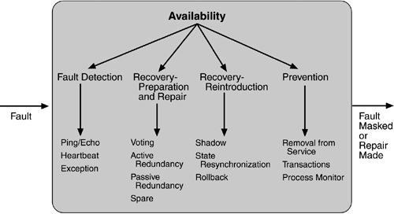
Tactics - Availability
Notes:
SWE30003 Software Architectures and Design
S1 2023
© Swinburne University of Technology
These tactics need to be explained in some more detail!
Note that they are from the second edition of the book – the third edition adds a few more…

Slide 9
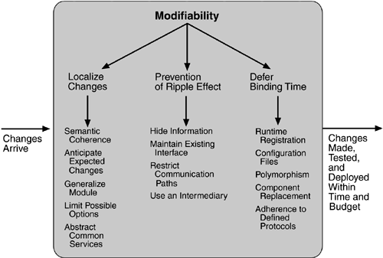
Tactics - Modifiability
Notes:
SWE30003 Software Architectures and Design
S1 2023
© Swinburne University of Technology
These tactics need to be explained in some more detail!

Slide 10
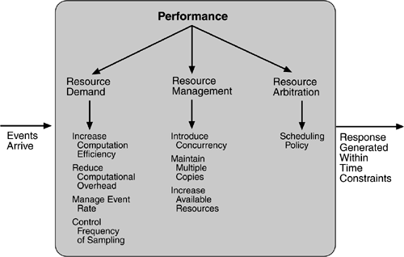
Tactics - Performance
Notes:
SWE30003 Software Architectures and Design
S1 2023
© Swinburne University of Technology
These tactics need to be explained in some more detail!

Slide 11
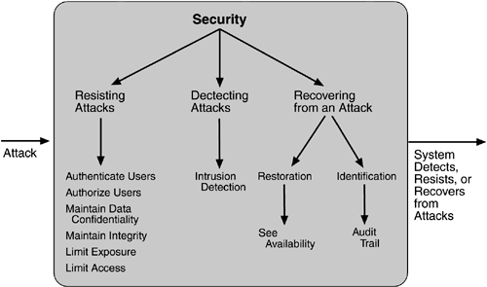
Tactics - Security
Notes:
SWE30003 Software Architectures and Design
S1 2023
© Swinburne University of Technology
These tactics need to be explained in some more detail!

Slide 12
Patterns vs. Tactics
“Any pattern implements several tactics, often concerned with different quality attributes, and any implementation of the pattern also makes choices about tactics.”
— Len Bass et al., Software Architecture in Practice, 2013
Notes:
SWE30003 Software Architectures and Design
S1 2023
© Swinburne University of Technology

Slide 13
Tactics in Patterns/Styles
What Architectural Tactics are used/applied in the following Patterns/Architectural Styles:
  Template Method
  Composite
  Observer / MVC
  Layers
Notes:
SWE30003 Software Architectures and Design
S1 2023
© Swinburne University of Technology
Discuss the mentioned Patterns/Architectural Styles from an Architectural Tactics perspective…

Slide 14
Outline
Architectural Tactics
Design Documentation
  Purpose of Documentation
  Views
  Notations
Design Evaluation
Notes:
SWE30003 Software Architectures and Design
S1 2023
© Swinburne University of Technology

Slide 15
Principal Focus
Why do we want to document software designs?
  special focus on architectural design
Who will be interested in reading documented designs?
Notes:
SWE30003 Software Architectures and Design
S1 2023
© Swinburne University of Technology

Slide 16
The role of Software Design
Bridging the gap between requirements and implementation
Assisting software engineers to develop software solutions to a given set of requirements
  to enable early verification of software solutions
  to produce a blue-print for implementation
Enhancing the communication between a project’s stakeholders
Notes:
SWE30003 Software Architectures and Design
S1 2023
© Swinburne University of Technology

Slide 17
Purpose of Architecture
Expression of the system and its evolution
Communication among the system stakeholders
Evaluation and comparison of architectures in a consistent manner
Planning, managing, and executing the activities of system development
Expression of the persistent characteristics and supporting principles of a system to guide acceptable change
Verification of a system implementation’s compliance with an architectural description
Recording contributions to the body of knowledge of software-intensive systems architecture
— Source: IEEE Standard 1471
Notes:
SWE30003 Software Architectures and Design
S1 2023
© Swinburne University of Technology

Slide 18
Any form of architectural documentation must address at least one of the purposes/goals of software architectures!
Notes:
SWE30003 Software Architectures and Design
S1 2023
© Swinburne University of Technology

Slide 19
Outline
Architectural Tactics_x0001_
Design Documentation
  Purpose of Documentation
  Views
  Notations
Design Evaluation
Notes:
SWE30003 Software Architectures and Design
S1 2023
© Swinburne University of Technology

Slide 20
Purpose of Documentation
Communication: communicating ideas about possible software solutions to stakeholders for feedback etc.
  Who is the audience? What do they want/need to know?
  What means of communication do they understand?
Focus on the big-picture ideas!
Specification: blue-print for implementation
  Purpose: a detailed design specification for implementers.
  Needs to avoid any form of ambiguity.
Focus on specific details!
Notes:
SWE30003 Software Architectures and Design
S1 2023
© Swinburne University of Technology
In the context of this unit, we are mostly interested in the big-picture ideas and communication, not specification…

Slide 21
Stakeholders of Software Projects
Customer
End-User
Developer
  Maintainer
Manager
Business Analyst
System Administrator
All have different interests and needs for documentation!
Notes:
SWE30003 Software Architectures and Design
S1 2023
© Swinburne University of Technology

Slide 22
Outline
Architectural Tactics_x0001_
Design Documentation
  Purpose of Documentation
  Views
  Notations
Design Evaluation
Notes:
SWE30003 Software Architectures and Design
S1 2023
© Swinburne University of Technology

Slide 23
Views
“A view is a representation of a coherent set of architectural elements, as written by and read by stakeholders. It consists of a representation of a set of [architectural] elements and the relationships amongst them.”
— Len Bass et al., Software Architecture in Practice (2nd Edition), 2003.
  Views focus on specific aspects of a software system by using appropriate abstractions!
Notes:
SWE30003 Software Architectures and Design
S1 2023
© Swinburne University of Technology
One can talk about various views of other types of “architectures” here…

Slide 24
Categories of Views
Component and Connector:
  Focus on (run-time) computational entities (i.e. components, processing elements) and their means of communication (i.e. connectors).
  What are the main executing components and how do they interact?
Allocation:
  Focus on computational entities and their (physical) environment.
  What processing node does each component execute on?
Module:
  Focus on code units and their responsibilities
  What packaging mechanisms are used to specify/implement each architectural element? How are these “packages” inter-related?
Notes:
SWE30003 Software Architectures and Design
S1 2023
© Swinburne University of Technology
In the conext of this unit, we are particularly focusing on C&C and allocation views!

Slide 25
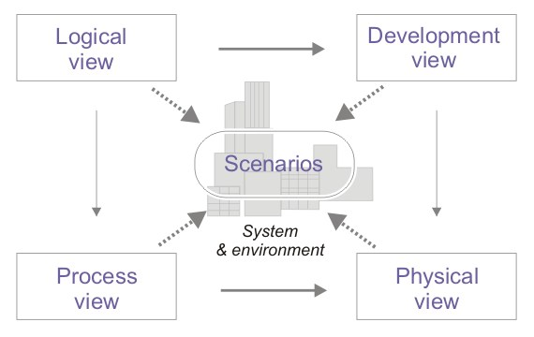
Kruchten’s 4+1 View
Notes:
SWE30003 Software Architectures and Design
S1 2023
© Swinburne University of Technology

Slide 26
Kruchten’s 4+1 View (cont.)
Logical View (Module View):
  concerned with the functionality that a system provides to end-users
Process View (Component & Connector View):
  focus on system processes (i.e. components) and how they communicate; addresses concurrency, distribution, performance, scalability etc.
Development View (Allocation View):
  illustrates a system from a developers perspective;
  concerned with software management
Physical View (Allocation View):
  concerned with mapping of components onto processing and communication nodes
Notes:
SWE30003 Software Architectures and Design
S1 2023
© Swinburne University of Technology

Slide 27
Kruchten’s 4+1 View (cont.)
Scenarios:
  illustration of architectural solution using selected use cases,
  describe sequences of interactions between system processes (i.e. processing elements),
  used to illustrate and verify the architectural design,
  serve as a starting point for tests and architectural prototypes.
In many situations, Kruchten’s 4+1 view model is a good starting point for documenting architectural designs.
Notes:
SWE30003 Software Architectures and Design
S1 2023
© Swinburne University of Technology

Slide 28
However…
“A neat-looking drawing of some boxes, circles, and lines, laid out nicely in Powerpoint or Word, does not constitute an architecture.”
— D’Souza & Wills
There is a need to assist developers in avoiding ambiguous notations!
Notes:
SWE30003 Software Architectures and Design
S1 2023
© Swinburne University of Technology
So PLEASE tell the reader what notation you are using when you draw a diagram!

Slide 29
IEEE Standard 1471
IEEE 1471 provides definitions and a meta-model for the description of software architectures.
Assumes that an architecture exists to address to specific stakeholder concerns.
Asserts that architectural descriptions are inherently multi-view
  no single view captures all stakeholder concerns
Separates the notion of view from viewpoint, where a viewpoint identifies the set of concerns and the representations/modeling techniques, etc. used to describe an architecture to address those concerns.
It provides for capturing rationale and inconsistencies/unresolved issues between the views within a single architecture description.
Notes:
SWE30003 Software Architectures and Design
S1 2023
© Swinburne University of Technology

Slide 30
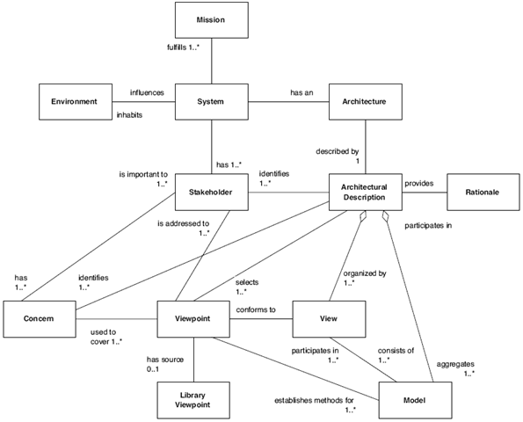
IEEE 1471 - Conceptual Framework
Notes:
SWE30003 Software Architectures and Design
S1 2023
© Swinburne University of Technology
IEEE 1471 uses the following conceptual framework:
1. A system’s environment, or context', can influence that system. The environment can include other systems that interact with the system of interest, either directly via interfaces or indirectly in other ways. The environment determines the boundaries that define the scope of the system of interest relative to other systems.
2. A system has one or more stakeholders. Each stakeholder typically has interests in, or concerns relative to, that system.
3. Concerns are those interests which pertain to the system’s development, its operation or any other aspects that are critical or otherwise important to one or more stakeholders. Concerns include system considerations such as performance, reliability, security, distribution, and evolvability.
4. A system exists to fulfill one or more missions in its environment. A mission is a use or operation for which a system is intended by one or more stakeholders to meet some set of objectives.
5. Every system has an architecture, whether understood or not; whether recorded or conceptual. An architecture can be recorded by an architectural description.
6. An architectural description is organized into one or more constituents called (architectural) views. Each view addresses one or more of the concerns of the system stakeholders. A view is a partial expression of a system’s architecture with respect to a particular viewpoint.
7. A viewpoint establishes the conventions by which a view is created, depicted and analyzed. In this way, a view conforms to a viewpoint. The viewpoint determines the languages (including notations, model, or product types) to be used to describe the view, and any associated modeling methods or analysis techniques to be applied to these representations of the view. These languages and techniques are used to yield results relevant to the concerns addressed by the viewpoint.
8. An architectural description selects one or more viewpoints for use. The selection of viewpoints is typically based on consideration of the stakeholders to whom the AD is addressed and their concerns. A viewpoint definition may originate with an AD, or it may have been defined elsewhere (a library viewpoint).
9. A view may consist of one or more architectural models. Each such architectural model is developed using the methods established by its associated architectural viewpoint. An architectural model may participate in more than one view.

Slide 31
Conceptual Framework - Motivation
Establish terms and concepts for architectural thinking
Serve as a basis for evolution of the field where little common terminology exists
Provide a means to talk about Architectural Descriptions in the context of
  System Stakeholders
  Life Cycle
  Uses of Architectural Description
Notes:
SWE30003 Software Architectures and Design
S1 2023
© Swinburne University of Technology

Slide 32
IEEE 1471 - Viewpoints
Views are well-formed:
  Each view corresponds to exactly one viewpoint,
  A viewpoint is a pattern for constructing views,
  Viewpoints define the rules on views.
No fixed set of viewpoints:
  IEEE 1471 is “agnostic” about where viewpoints come from,
  Defines templates how viewpoints are declared.
Concerns drive viewpoint selection:
  Each concern of a system is addressed by one (or many) architectural view(s).
Notes:
SWE30003 Software Architectures and Design
S1 2023
© Swinburne University of Technology

Slide 33
IEEE 1471 - Viewpoints (cont.)
Each viewpoint is specified by:
  Viewpoint name
  The stakeholders addressed by the viewpoint
  The stakeholder concerns to be addressed by the viewpoint
  The viewpoint “language”, modeling technique, or analytical method used
  The source, if any, of the viewpoint (e.g., author, literature citation)
Notes:
SWE30003 Software Architectures and Design
S1 2023
© Swinburne University of Technology

Slide 34
Viewpoint - Example
Viewpoint name: Capability
Stakeholders:
  client, producers, developers, and integrators
Concerns:
  How is functionality packaged?
  What interfaces are managed?
Viewpoint language:
  Components and their dependencies (UML component diagrams)
  Interfaces and their attributes (UML class diagrams)
Also known as: Static, Application, Structural viewpoints
Notes:
SWE30003 Software Architectures and Design
S1 2023
© Swinburne University of Technology

Slide 35
Outline
Architectural Tactics_x0001_
Design Documentation
  Purpose of Documentation
  Views
  Notations
Design Evaluation
Notes:
SWE30003 Software Architectures and Design
S1 2023
© Swinburne University of Technology

Slide 36
Graphical Notations
Popular approach to document software architectures using graphical notations
  “a picture can convey more than a thousand words”
Generally easy to understand and use
  Tool support for selected notations available (e.g., UML)
If not used systematically, may lead to ambiguity
Do not lend themselves for further systematic analysis
  Principal purpose: communication (not specification)
Notes:
SWE30003 Software Architectures and Design
S1 2023
© Swinburne University of Technology
Talk a bit more about graphical notations in general here…

Slide 37
“De-facto” standard: Unified Modeling Language
Why UML?
Reduces risks by documenting assumptions
  domain models, requirements, architecture, design, implementation …
Represents industry standard
  more tool support, more people understand your diagrams, less education
Is “reasonably” well-defined
  ... although there are interpretations and dialects (and versions) …
Is open
  stereotypes, tags and constraints to extend basic constructs
  has a meta-meta-model for advanced extensions
Notes:
SWE30003 Software Architectures and Design
S1 2023
© Swinburne University of Technology

Slide 38
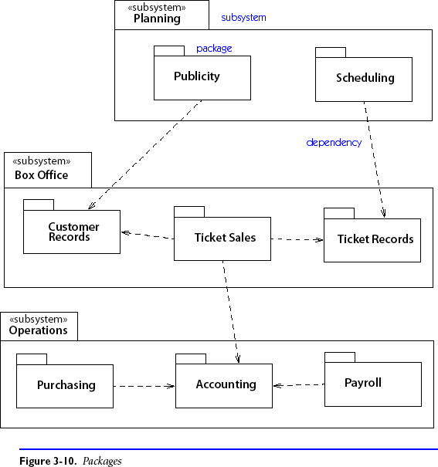
UML support: Package Diagram
Decompose system into packages (containing any other UML element, incl. packages)
Notes:
SWE30003 Software Architectures and Design
S1 2023
© Swinburne University of Technology
A package diagram is suitable for a C&C view

Slide 39
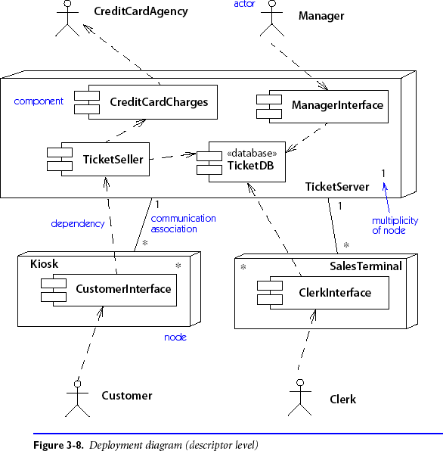
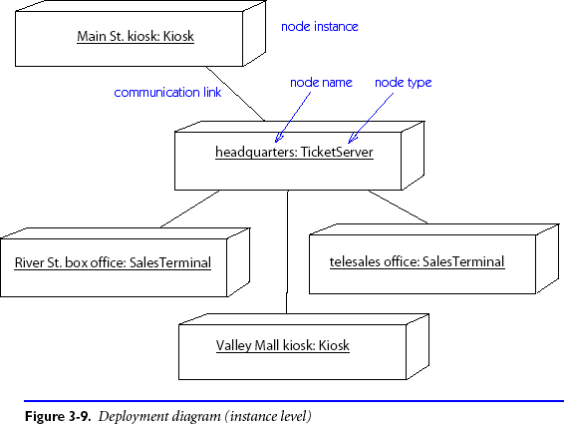
UML support: Deployment Diagram
Physical layout of run-time components on hardware nodes.
Notes:
SWE30003 Software Architectures and Design
S1 2023
© Swinburne University of Technology
A deployment diagram is primarily suitable for an Allocation View

Slide 40
Architectural Description Languages
Can be characterized as very-high level “programming” languages
  Exhibit many properties of a programming language;
  may not necessarily be computationally complete!
Basic building blocks are high-level architectural elements:
  Components, Connectors, and Configurations
  (syntactical) Support for modular decomposition
Subsume some formal semantic model
  Suitable for (formal) analysis and reasoning
  Tool support for reasoning and model checking
Main purpose: specification (not communication)
Notes:
SWE30003 Software Architectures and Design
S1 2023
© Swinburne University of Technology

Slide 41
Example - Darwin
component pipeline (int n) {
provide input;
require output;
array F[n]:filter;
forall k:0..n-1 {
inst F[k];
when k<n-1 bind
F[k].next -- F[k+1].prev;
}
bind
input -- F[0].prev;
F[n-1].next -- output;
}
Notes:
SWE30003 Software Architectures and Design
S1 2023
© Swinburne University of Technology

Slide 42
C4 MODEL

Slide 43

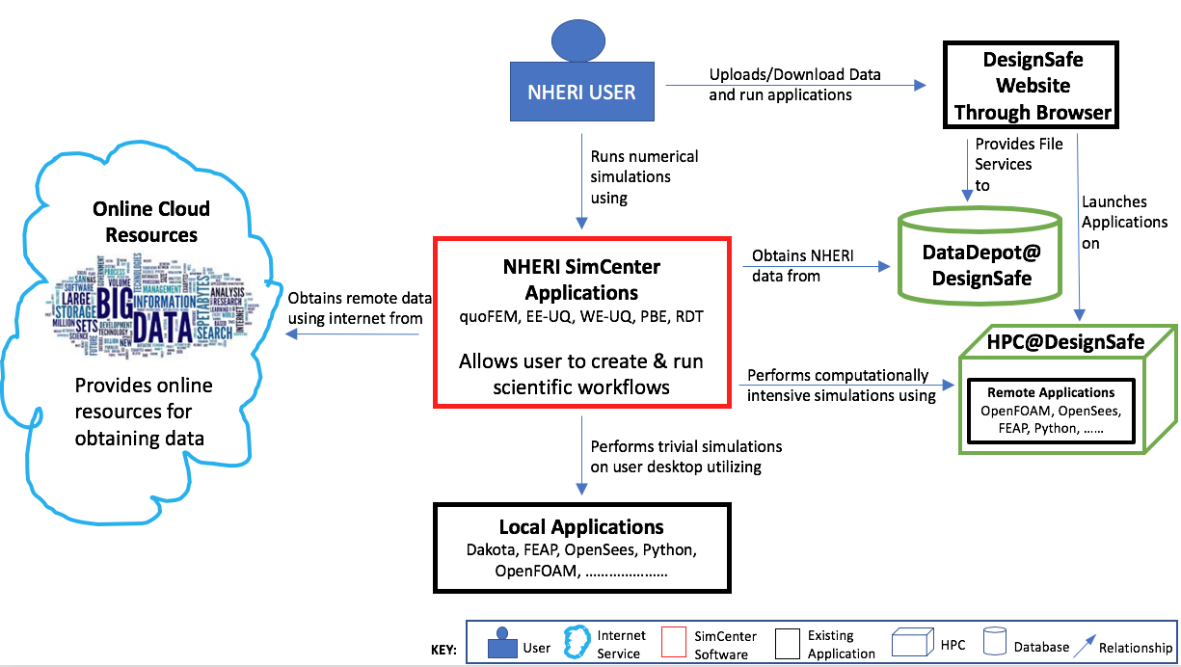

Slide 44

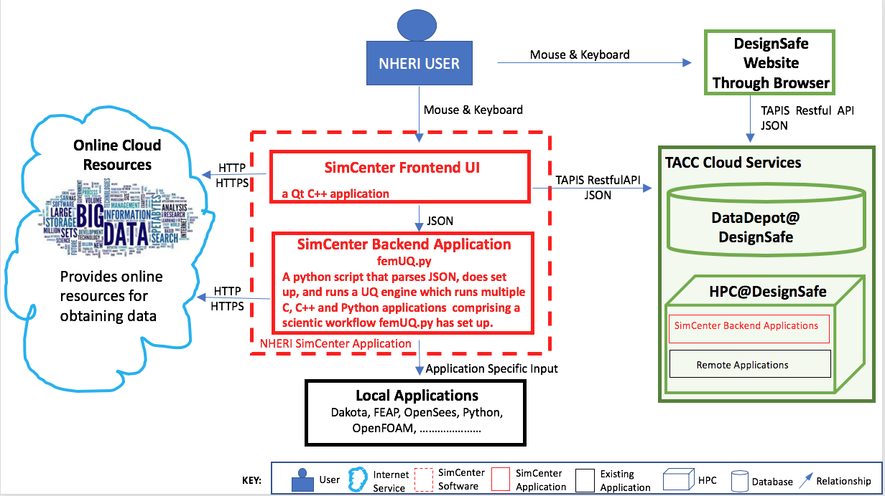

Slide 45

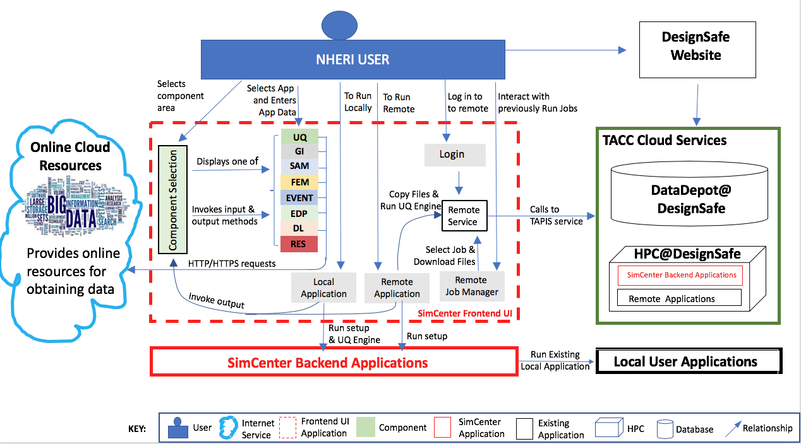

Slide 46

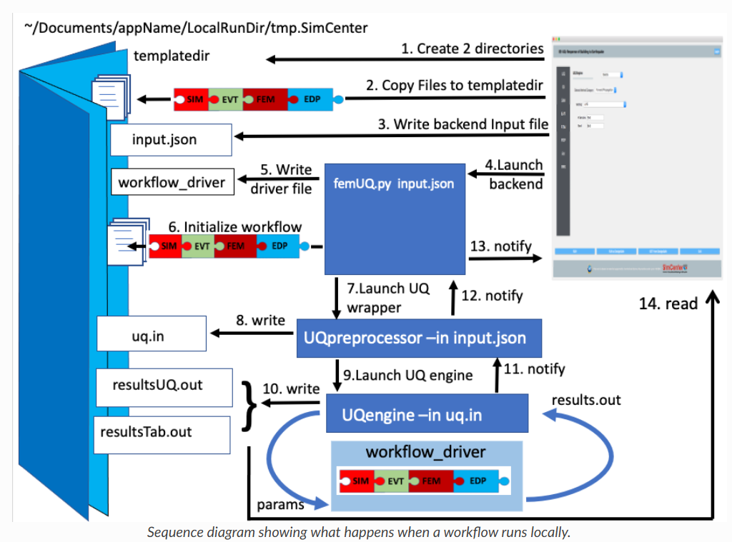

Slide 47
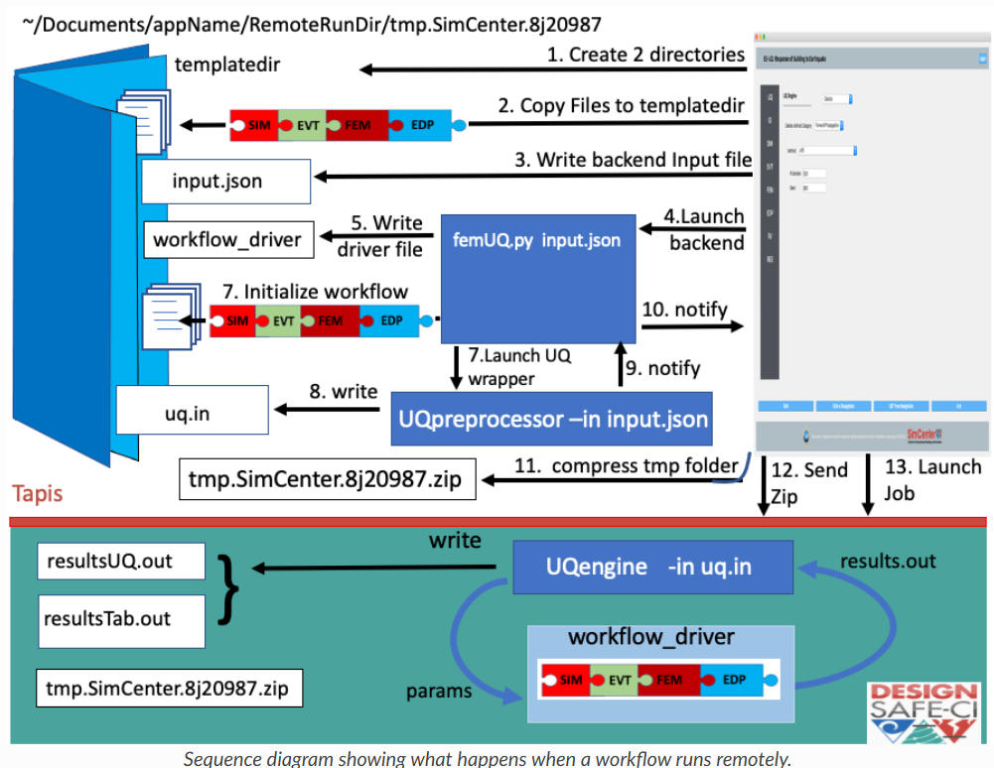

Slide 48
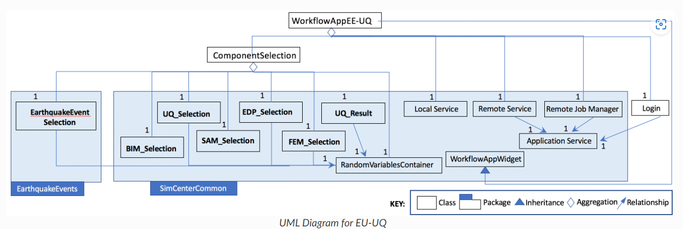
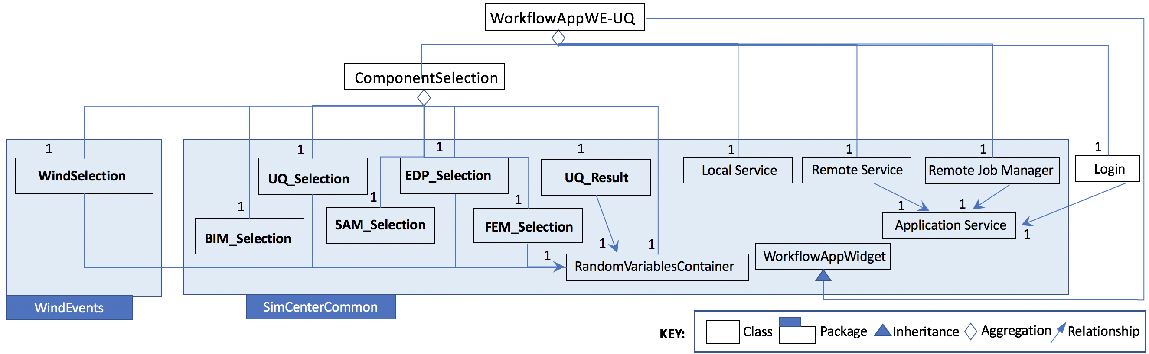

Slide 49
Reference: C4 Model of the SimCenter Ecosystem — Performance Based Engineering Application documentation (nheri-simcenter.github.io)
Notes:
SWE30003 Software Architectures and Design
S1 2023
© Swinburne University of Technology

Slide 50
Additional Reading Material
Philippe B. Kruchten, The 4+1 View Model of Architecture, IEEE Software, 12(6): 42—50, November 1995.
Dilip Soni, Robert L. Nord and Christine Hofmeister, Software Architecture in Industrial Applications, Proceedings ICSE '95, April 1995, pp. 196—207.
Robert J. Allen, A Formal Approach to Software Architecture, Ph.D. thesis, School of Computer Science, Carnegie Mellon University, Pittsburgh, May 1997.
Notes:
SWE30003 Software Architectures and Design
S1 2023
© Swinburne University of Technology

Slide 51

Documenting Software Architectures
Second Edition of the “Documenting Software Architectures” book available.
Draft version of the first edition available on Canvas (for your reference).

Slide 52
Outline
Architectural Tactics_x0001_
Design Documentation
  Purpose of Documentation
  Views
  Notations
Design Evaluation
Notes:
SWE30003 Software Architectures and Design
S1 2023
© Swinburne University of Technology

Slide 53
Why Evaluate Software Designs?
Early detection of design flaws
  Improve quality of designs
  Opportunity to fix flaws before any code is written
Early verification of architectural drivers
  special focus on quality attributes
Enhance “motivation” for improved design documentation
(Yet another opportunity to) validate requirements
Manage both quality and risks
Notes:
SWE30003 Software Architectures and Design
S1 2023
© Swinburne University of Technology
This list is by far not exhaustive!

Slide 54
Benefits
Improved articulation and verification of critical architectural drivers and quality attributes
  Identification (and resolution) of conflicting goals
  Improved software quality
Forces clear explanation (and documentation) of critical design issues
  In particular at an architectural level
  Improved architectural rationale
Enhances communication between stakeholders
  Evaluation can only happen by interacting stakeholders
Notes:
SWE30003 Software Architectures and Design
S1 2023
© Swinburne University of Technology

Slide 55
… and Costs
Like any quality assurance activity, software evaluations are not for free:
  Time
  Money
  … Frustration…
Notes:
SWE30003 Software Architectures and Design
S1 2023
© Swinburne University of Technology

Slide 56
Architecture Tradeoff Analysis Method
“Heavy-weight” method to systematically analyze software architectures
  Comprehensive process with 5 phases/9 stages
  Involves most stakeholders
    a large number of people required for a quality review!
  May take up several days (if not weeks)
  Delivers comprehensive risk analysis of a given architectural design
But experience shows that
  many design deficiencies may be uncovered if all parties are genuinely interested in the process!
Notes:
SWE30003 Software Architectures and Design
S1 2023
© Swinburne University of Technology

Slide 57
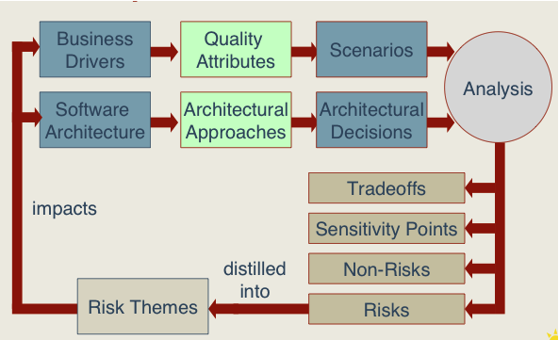
Conceptual Flow of the ATAM
Notes:
SWE30003 Software Architectures and Design
S1 2023
© Swinburne University of Technology

Slide 58
Output of ATAM
A concise presentation of the architecture
Defined (and evaluated) business goals
Quality requirements via a collection of scenarios
Mapping of architectural decisions to quality requirements
A set of risks, tradeoffs, and sensitivity points
Notes:
SWE30003 Software Architectures and Design
S1 2023
© Swinburne University of Technology

Slide 59
Benefits of ATAM
Gets stakeholders of project together
Enforces critical quality goals
Prioritization of conflicting goals
Forces clear architecture presentation/rationale
Improves quality of architectural documentation
Risk identification early in the development lifecycle
Cannot hide behind “fluff”
Notes:
SWE30003 Software Architectures and Design
S1 2023
© Swinburne University of Technology

Slide 60
But what about if an evaluation method
such as ATAM is perceived to be too heavy-weight?
Can we isolate and apply important concepts independent of ATAM?
Notes:
SWE30003 Software Architectures and Design
S1 2023
© Swinburne University of Technology

Slide 61
“The Essentials”
Architectural Drivers
Prioritized Quality Attributes
  adapt the idea of a Quality Utility Tree
Scenarios
Risk assessment
A more “light-weight”, checklist driven approach that focuses on essential elements may suffice!
Notes:
SWE30003 Software Architectures and Design
S1 2023
© Swinburne University of Technology

Slide 62
Quality Utility Tree
Identification and prioritization of the most important quality requirements by building a utility tree:
  A utility tree is a top-down vehicle for characterizing the “driving” attribute-specific requirements (i.e. architectural drivers)
  Select the most important quality attributes to be the high-level nodes (typically performance, modifiability, security, availability etc.)
  Add specific quality requirements at the next level
  Scenarios are the leaves of the utility tree
  Assess leaves based on (i) importance and (ii) degree of difficulty
    include skill and knowledge gaps in your assessment!
Results in a characterization and a prioritization of specific quality attribute requirements.
Notes:
SWE30003 Software Architectures and Design
S1 2023
© Swinburne University of Technology

Slide 63
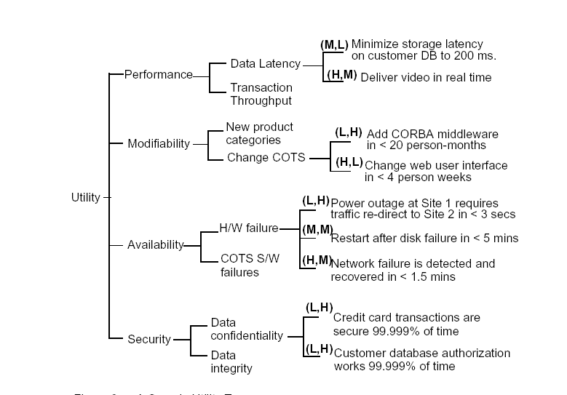
Quality Utility Tree - Example
Quality Attribute
Scenario
Quality
Requirement
Low importance
High difficulty
Notes:
SWE30003 Software Architectures and Design
S1 2023
© Swinburne University of Technology
I need to explain what we will now do with this tree ->prioritize scenarios, ask questions (I.e. how have these scenarios been addressed), record risks

Slide 64
A Basic Truth
Any form of organized quality assurance approach is better than none…
Evaluating the (architectural) design of a software system is such an organized QA approach.
Notes:
SWE30003 Software Architectures and Design
S1 2023
© Swinburne University of Technology

Slide 65
Questions for Consideration
What type(s) of View(s) would best be used to describe the various elements of the messenger system from the previous weeks question? Explain your reasoning.
If you maintain a popular site that cannot afford to have any downtime. Which tactic would be the most useful to stop a DDoS from halting your site?
What are the advantages and disadvantages of having one set of documentation for an architecture available for all stakeholders vs individually crafted sets of documentation for each group of stakeholders within a project?
Software Architecture in Practice (2nd Edition, Chapter 5) highlights that there are three ways to achieve the quality attribute availability. These three methods are Ping/Echo, Heartbeat and Exceptions. Discuss the advantages and disadvantages of each, and an appropriate scenario for each of them.
Notes:
SWE30003 Software Architectures and Design
S1 2023
© Swinburne University of Technology

Slide 66
“Question” to Answer
Using six sentences, summarize the most important/key concepts that were covered in this Unit of Study and illustrate why these concepts are important for developing (large-scale) software systems.
------- A self exercise.
Notes:
SWE30003 Software Architectures and Design
S1 2023
© Swinburne University of Technology

Slide 67
Required Reading Week 12
Len Bass, Paul Clements, and Rick Kazman, Software Architecture in Practice (4th or 3rd Edition), Addison-Wesley, Chapter 21.
----------------
Week 12:
Review … & Info on Final Test
Notes:
SWE30003 Software Architectures and Design
S1 2023
© Swinburne University of Technology

